Slide 1

Analysis of Health in The United States (21’-22’)
Adam Grimm
DS2020 – Fall 2024

Slide 2
The Data
Dataset from CDC (Places Project)
State, County, Local Data
Data on Disability, Health Outcomes, Prevention, Health Risk Behaviors, Health Status, and Health Related Social Needs

Slide 3
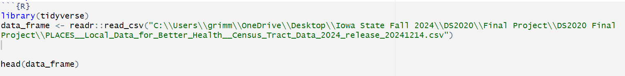
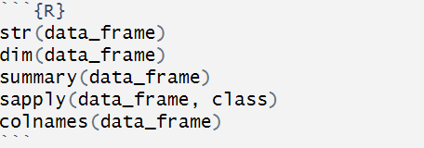
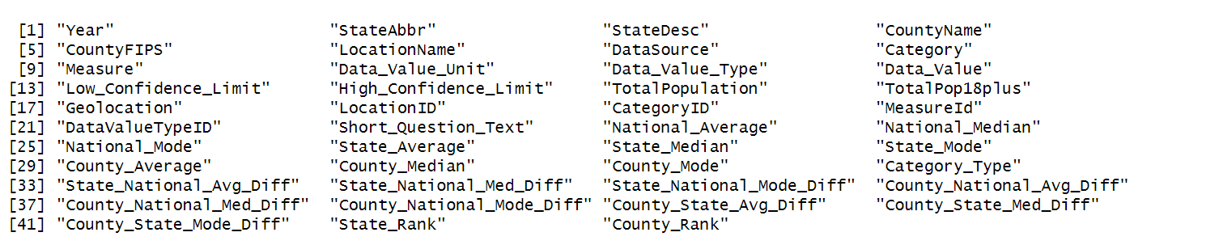
Loading and Survey the Dataset
Loading was straight forward
Dataset was initially 3,183,048 rows by 24 columns
Datatypes Numeric, Character, Logical
Population
Confidence Levels (High/Low)
GPS Coordinates

Slide 4
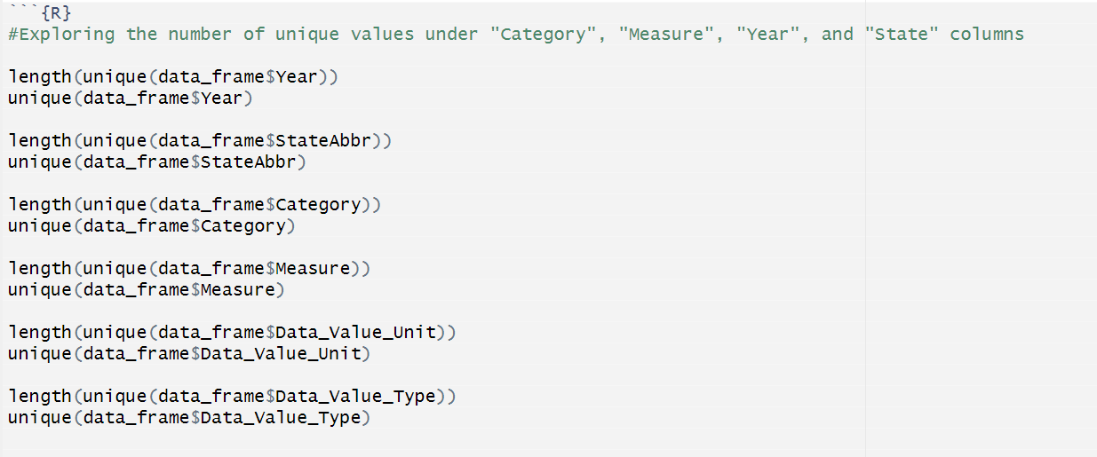
Surveying the Dataset cont.
I wanted to find the unique number of values for each column and see what they were
Dataset was for 2021, and 2022
There were six Category Values
There were 40 Measure or “Outcome” Values
Data Values are presented in percent

Slide 5
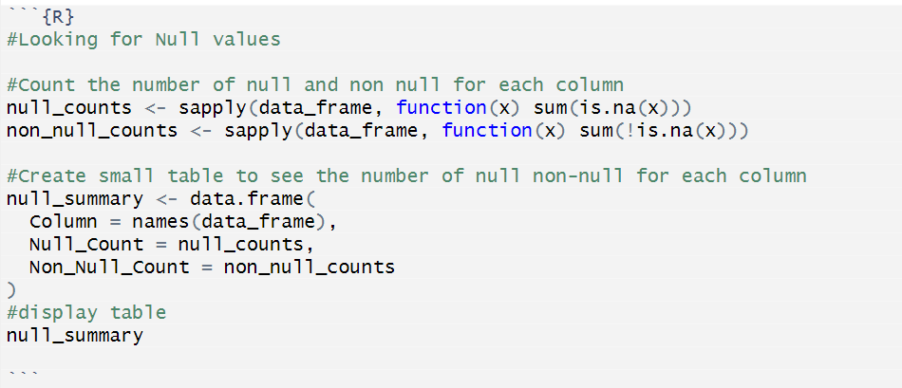
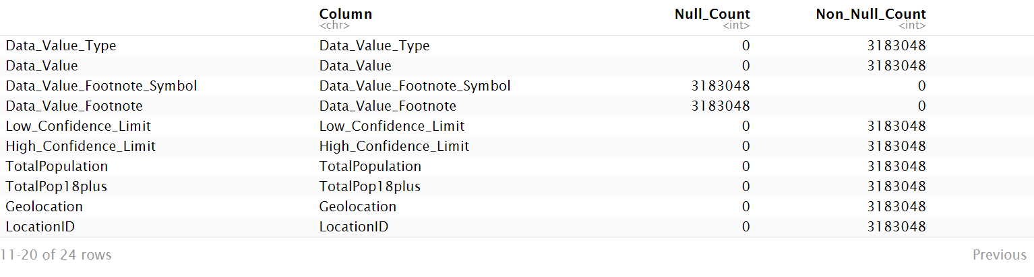
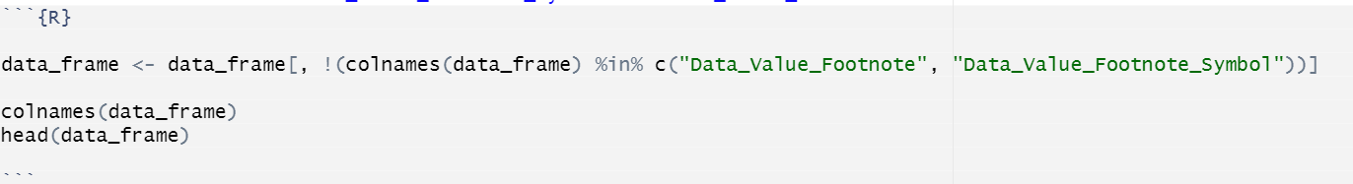
Cleaning
There wasn’t much cleaning to do
Searched for null values
Deleted columns Data_Value_Footnote_Symbol and Data_Value_Footnote

Slide 6
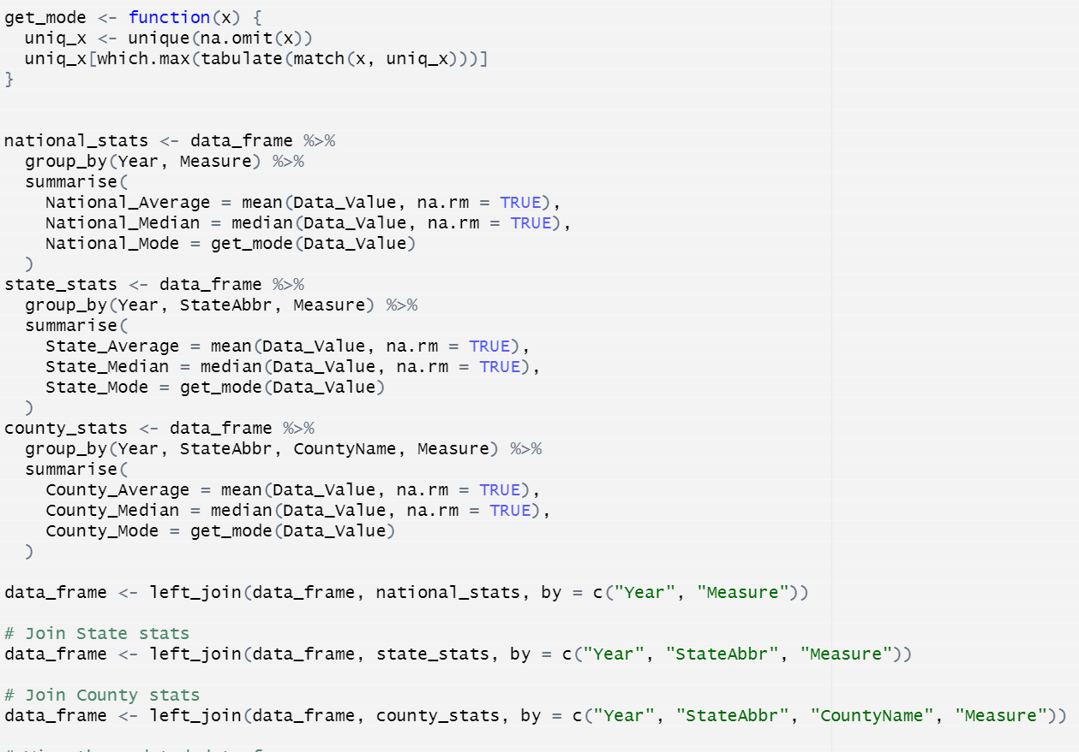
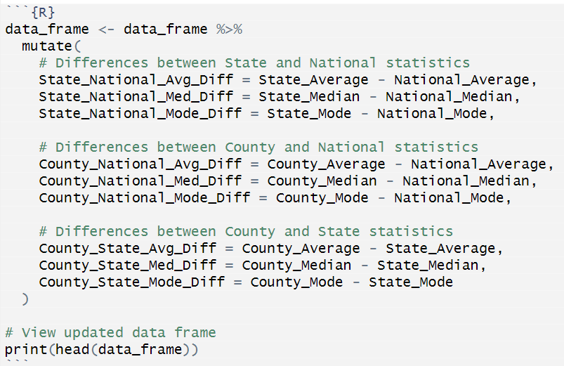
Data Manipulation
Data didn’t contain National averages, so I had to find that myself
Found Mean, Median, Mode for Nation, States and County for each “Measure”/Outcome created new columns for these numbers
Found difference between National Mean, Median, Mode State, and County levels
The difference between the National/State/County will be used to help visualize differences.

Slide 7
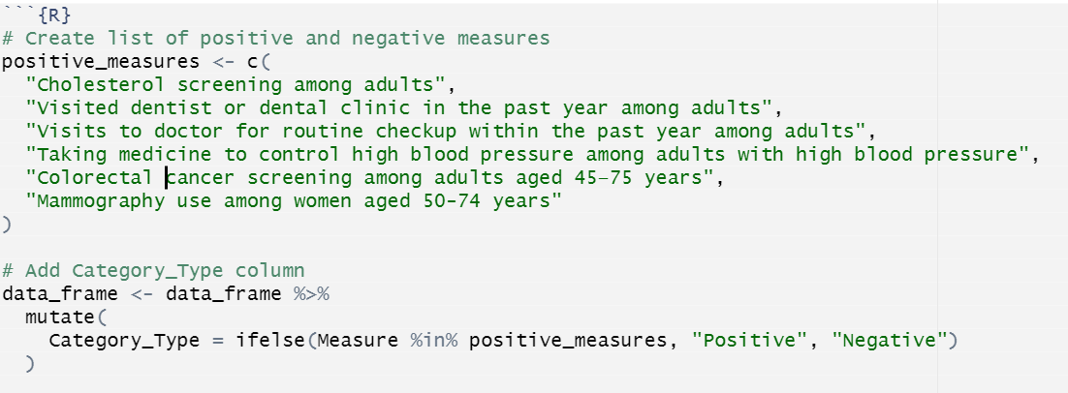
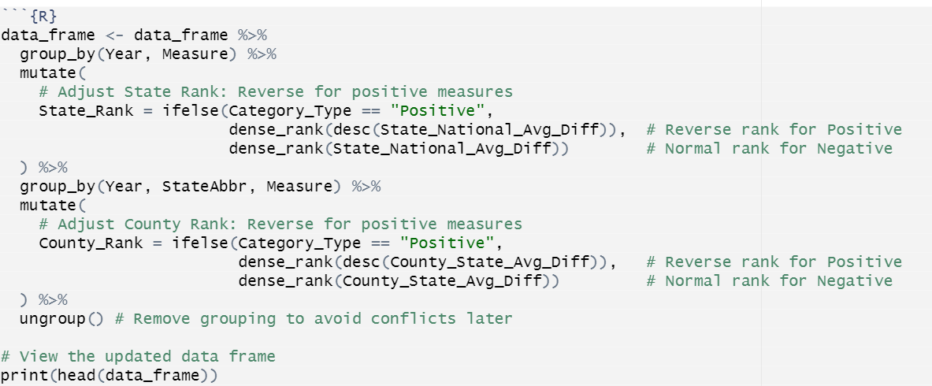
More Data Manipulation
Most categories were “Negative” a larger number indicates a worse outcome, but a few were not
These were mostly preventative measures, number of screenings done, number of people vising doctors etc..
I had to differentiate between the “Negative” and “Positive” numbers so they can be accurately visualized
I then “Ranked” each state and county compared to the national average, and reversed the count for “Positive” outcomes

Slide 8
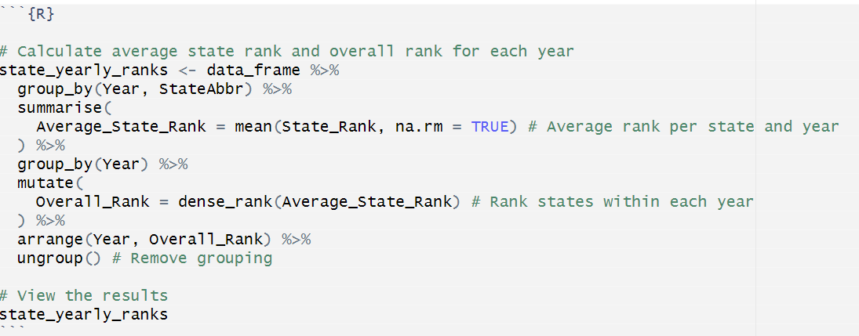
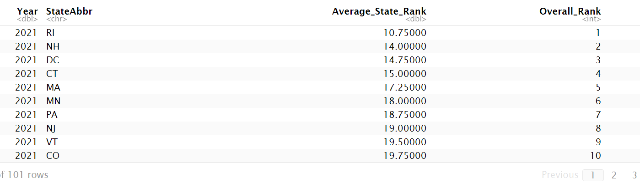
Data Exploration
I wanted to find an overall “Best and Worst” state for outcomes.
Created a new data frame state_yearly_ranks to show each states outcome ranks by year
I had to average together each states’ rank for each measure
This is flawed methodology, but it very roughly works.

Slide 9
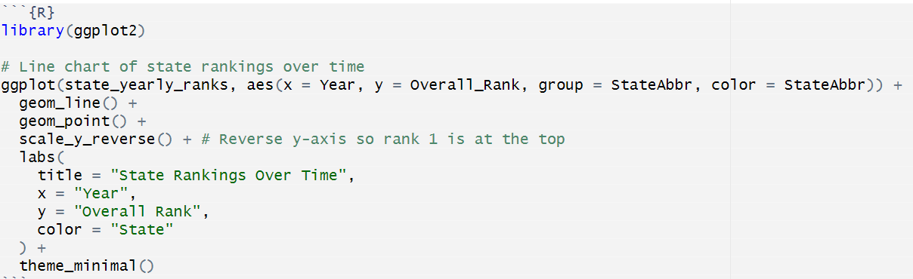
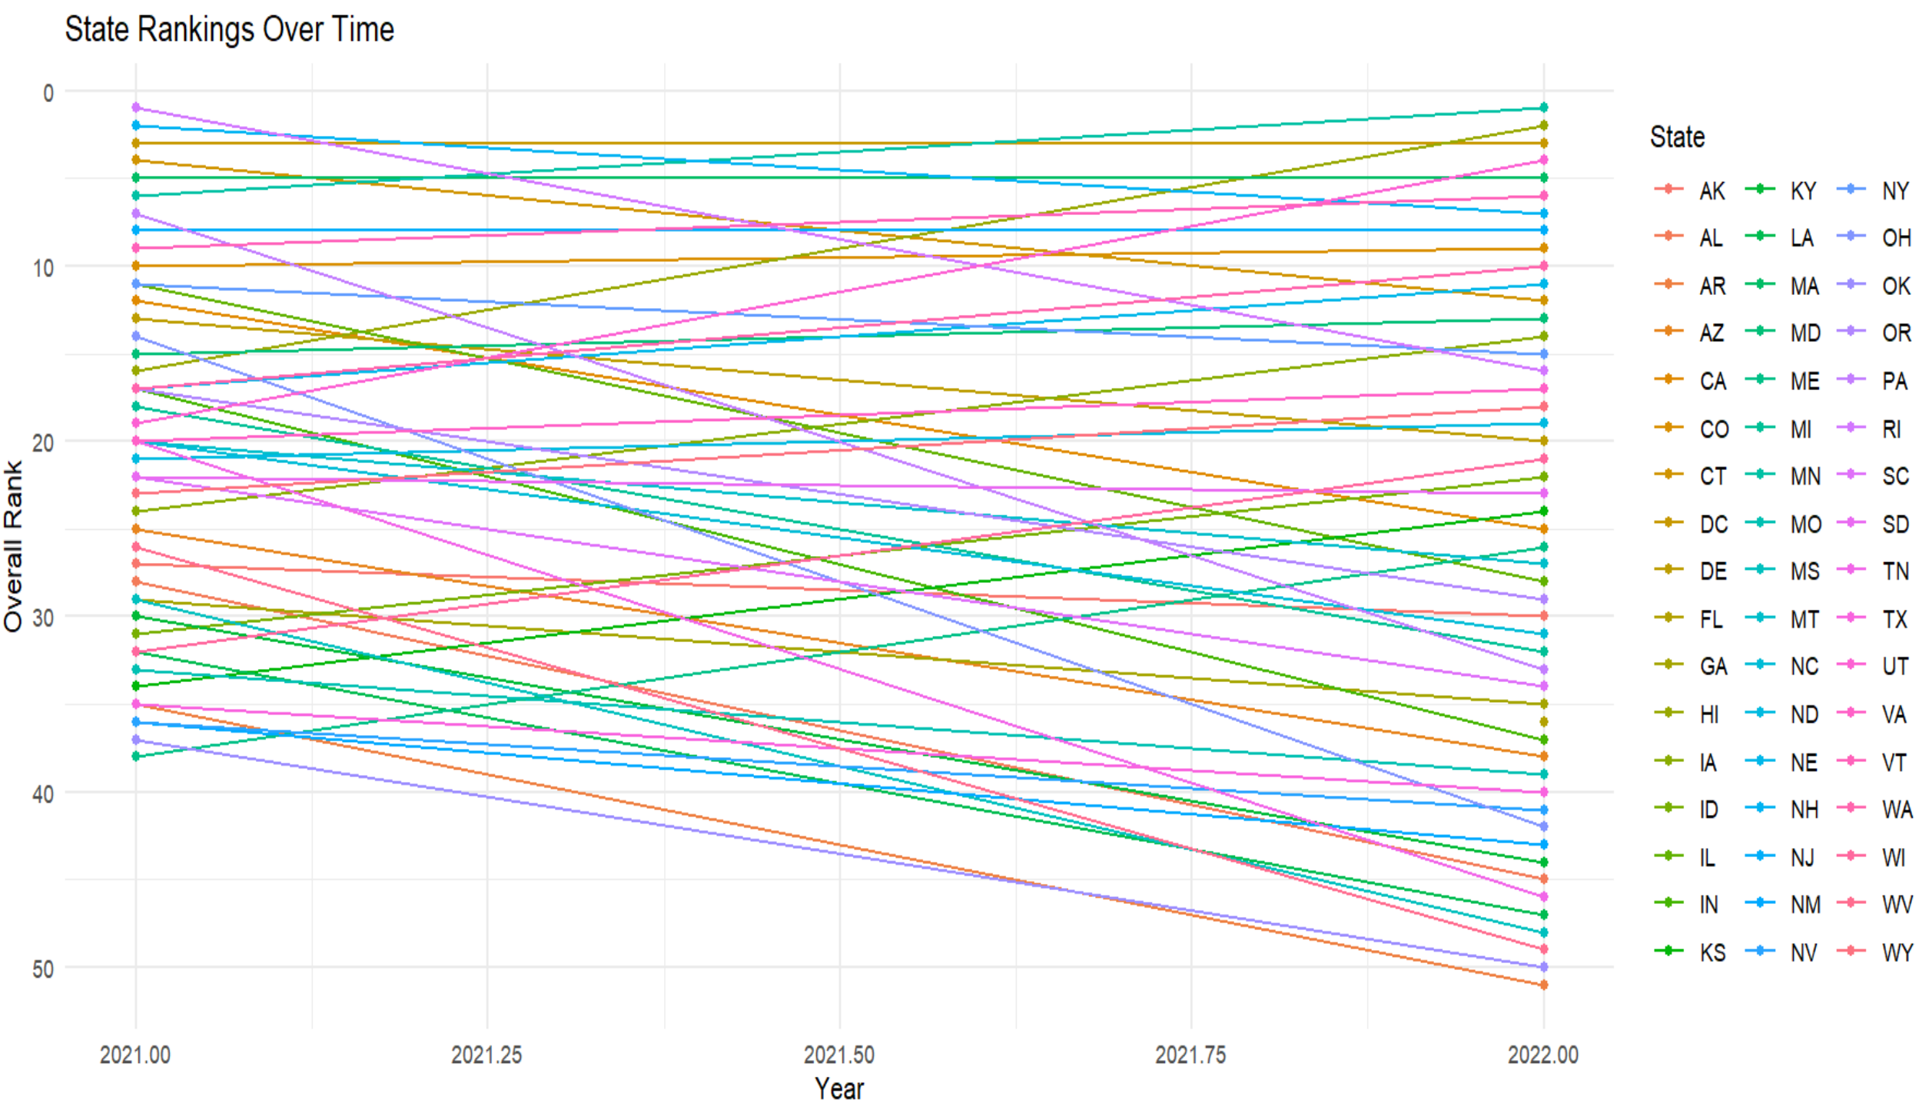
Data Exploration
I wanted to see what changes there were from 2021 to 2022 for my overall ranking score
2021 had the issue of there being multiple ties for spots
I should have found a way to break the ties so the graph is a bit less confusing.

Slide 10
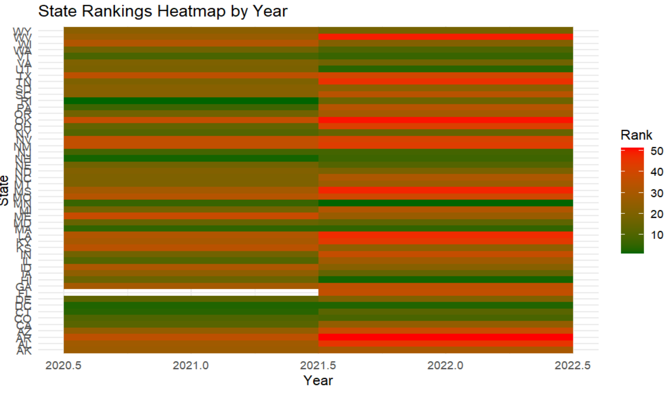
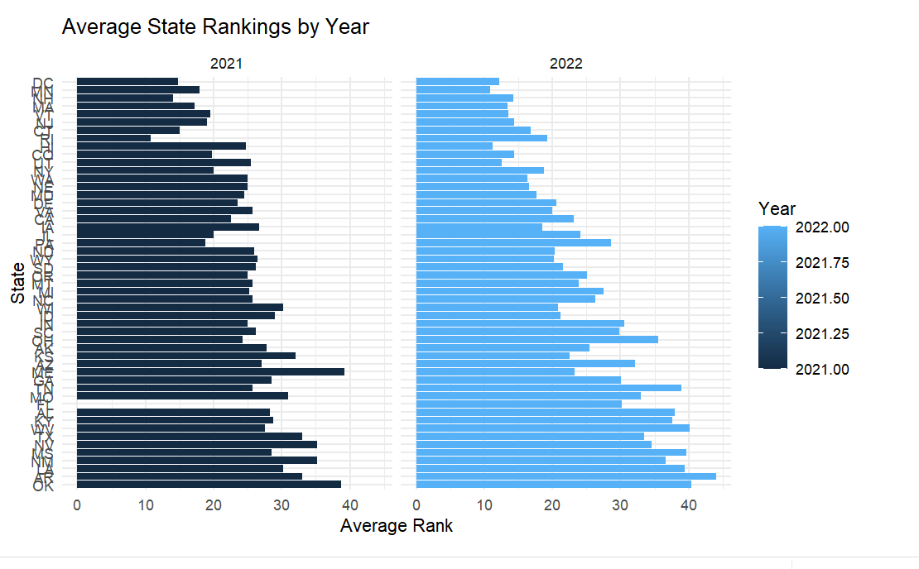
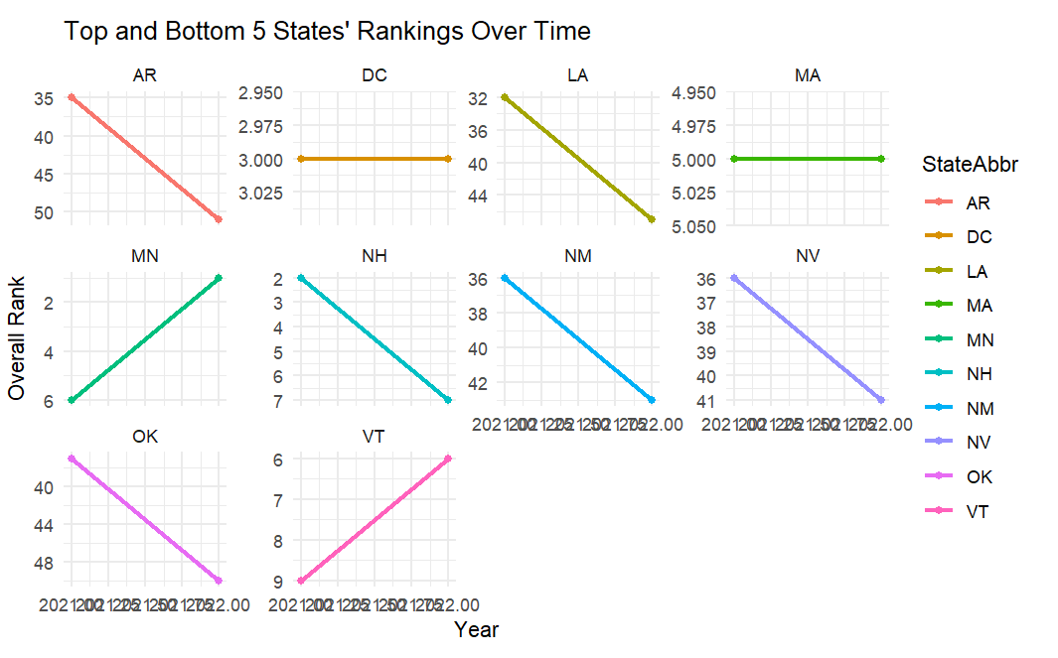
Data Exploration
Here I started to find out my dataset wasn’t complete FL was missing from 2021
Some trends are starting to emerge for the heathier states and less healthy

Slide 11
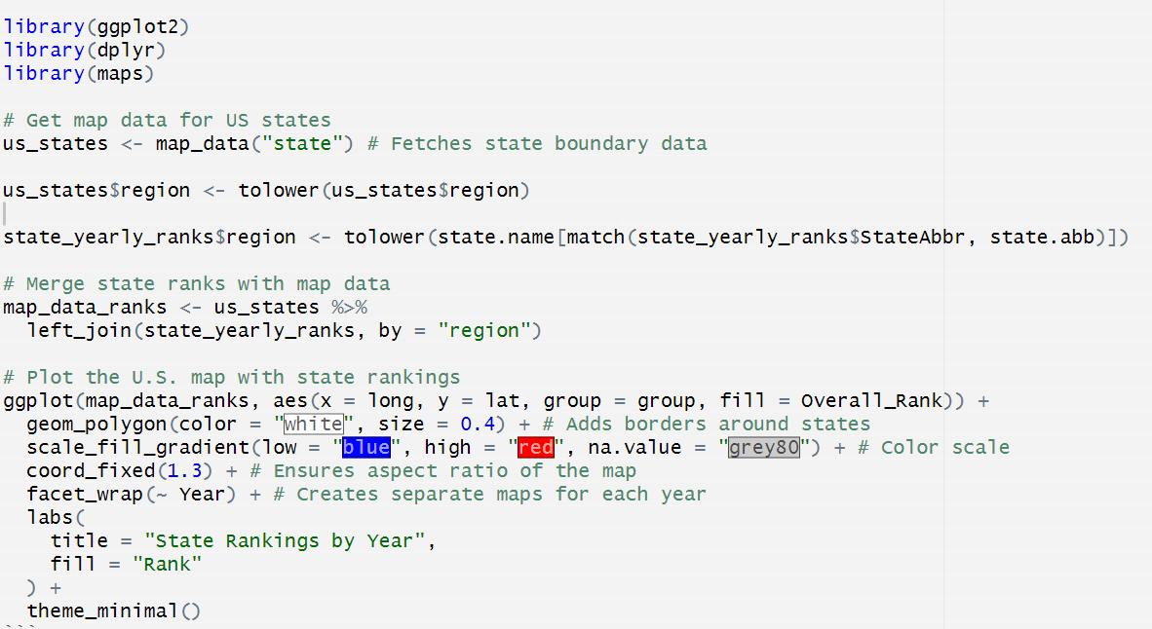
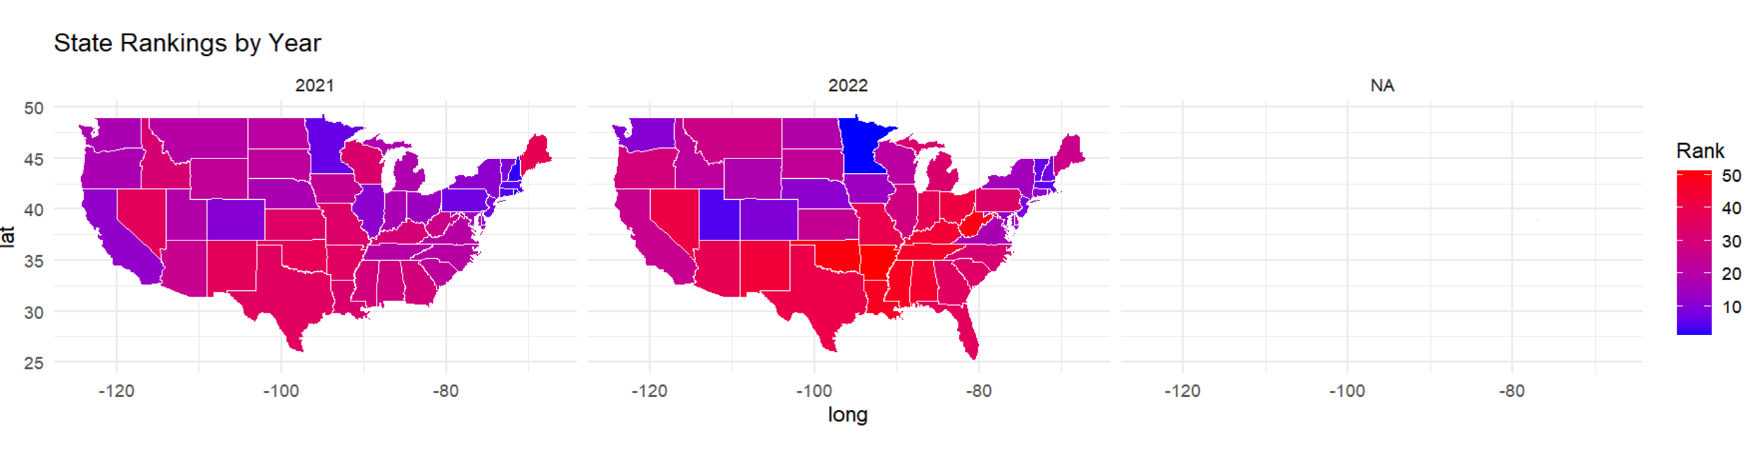
Data Exploration
I wanted now to see how the data looked on a map
The upper Midwest, New England and West Coast emerging as healthier regions, and the south as less healthy
I couldn’t figure out why I was getting a NA map

Slide 12
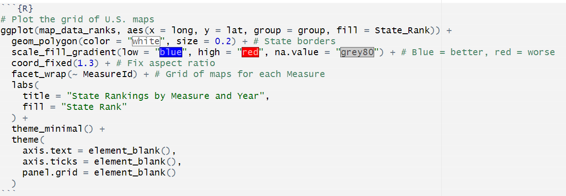
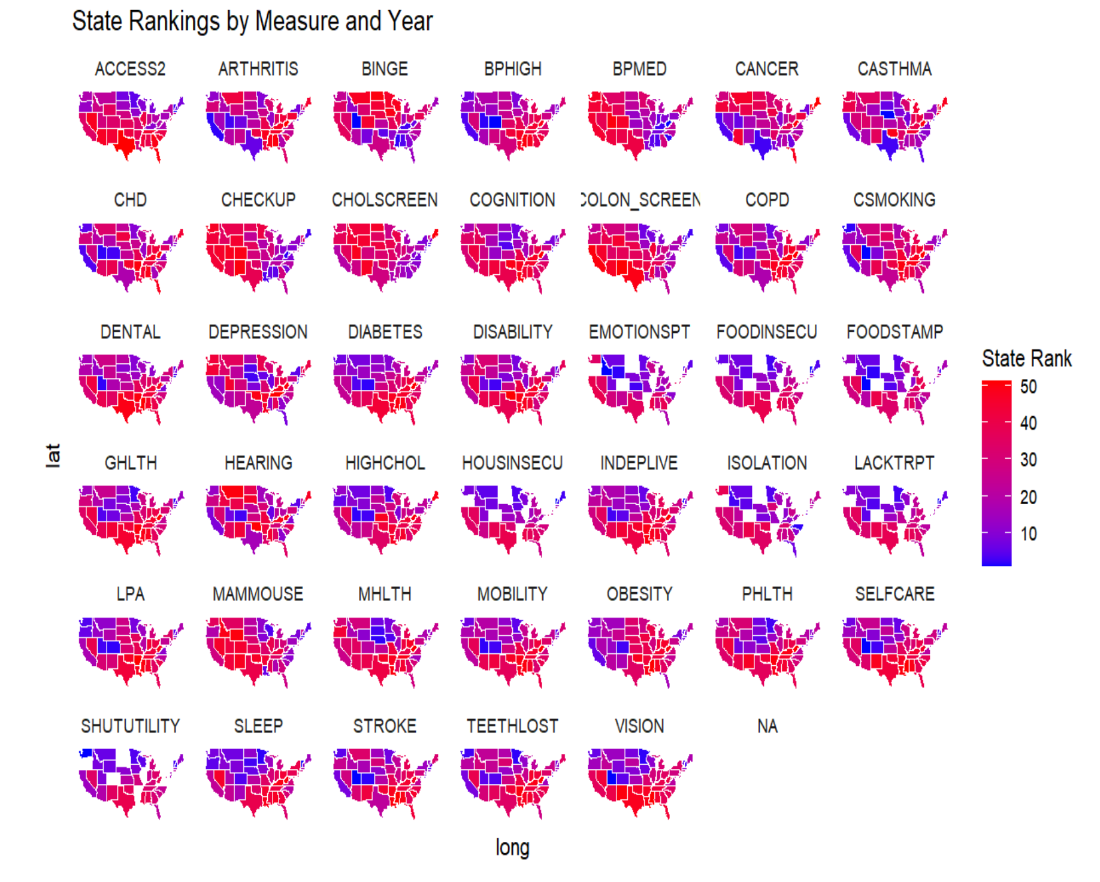
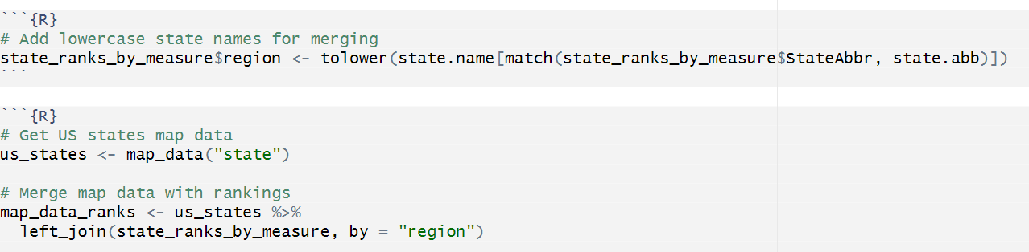
Data Exploration
I wanted to see all of the outcomes next to each other to visualize it better
Had to create new data frame to include Measures into a new map
Created a graph with each Outcome Ranked for each state
Some states are missing data

Slide 13
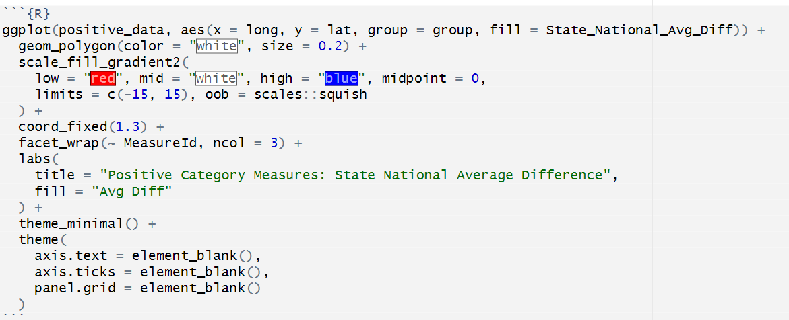
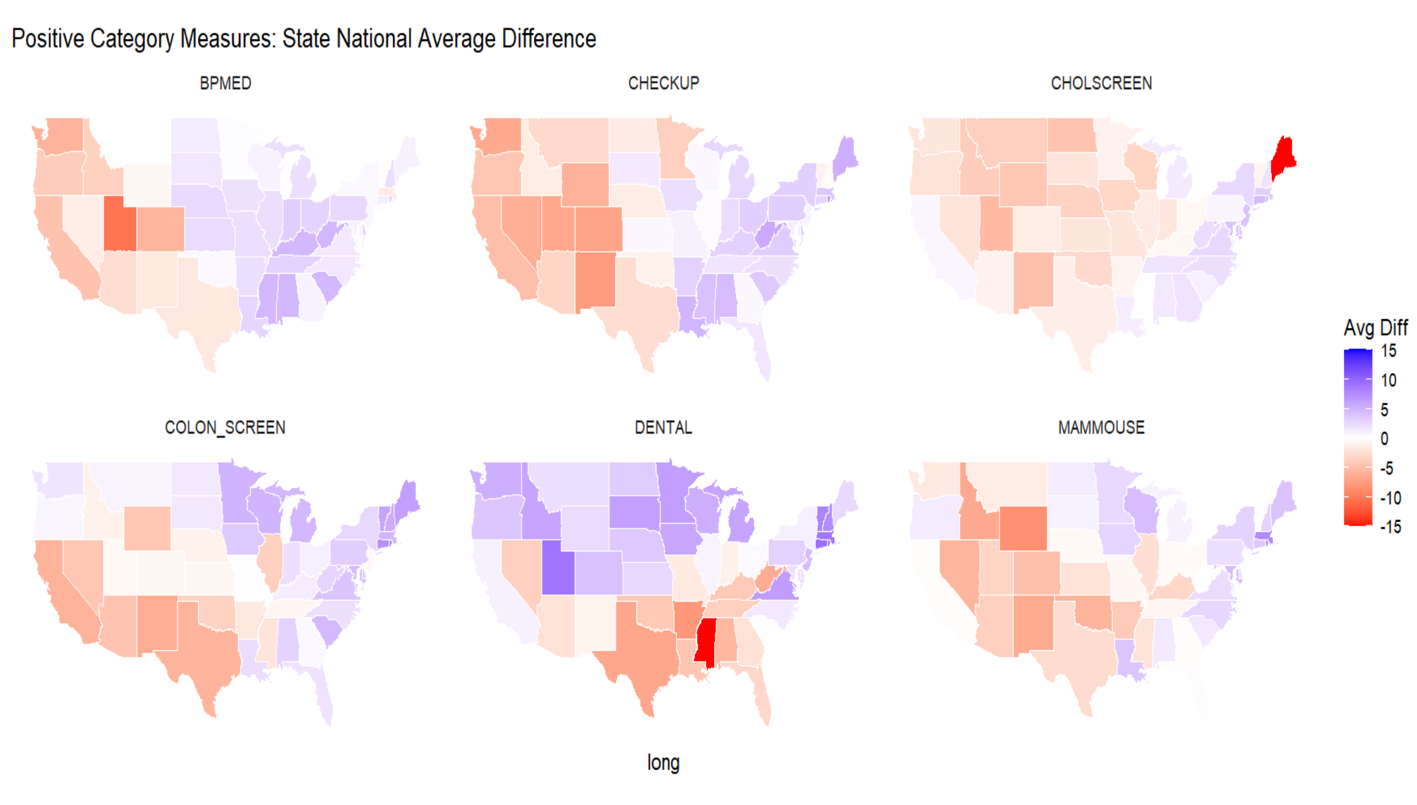
Data Exploration
I wanted to see a similar comparison but for the “Positive” outcomes
BPMED “Takes Blood Pressure Medication” should have been with negative outcomes.
It also seems like Checkups may only be necessary where people are less healthy

Slide 14
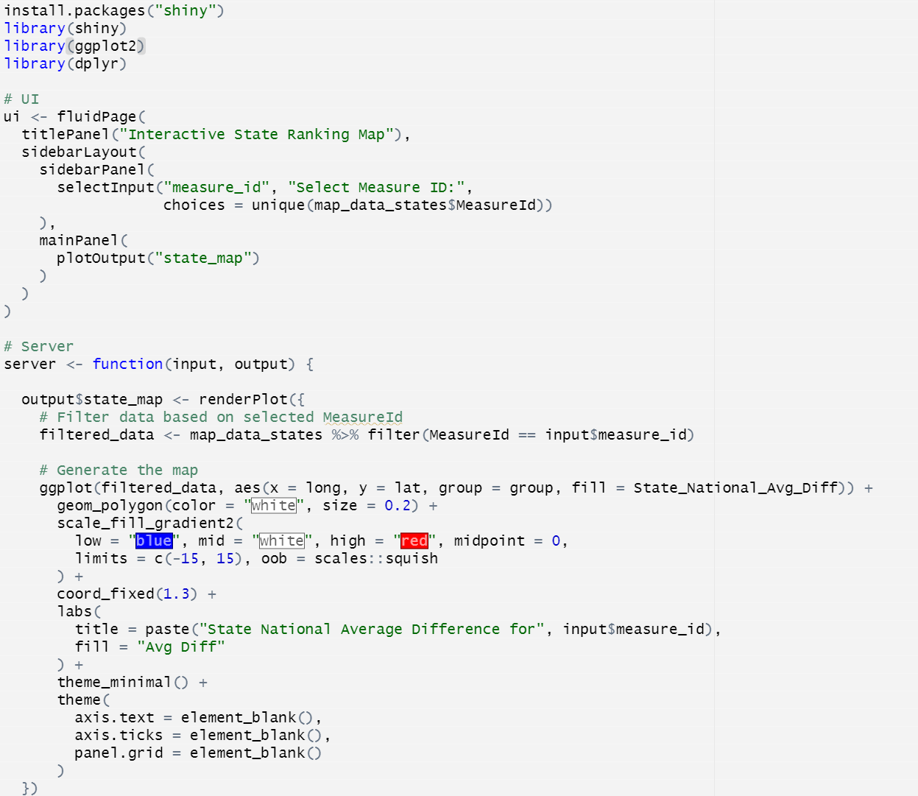
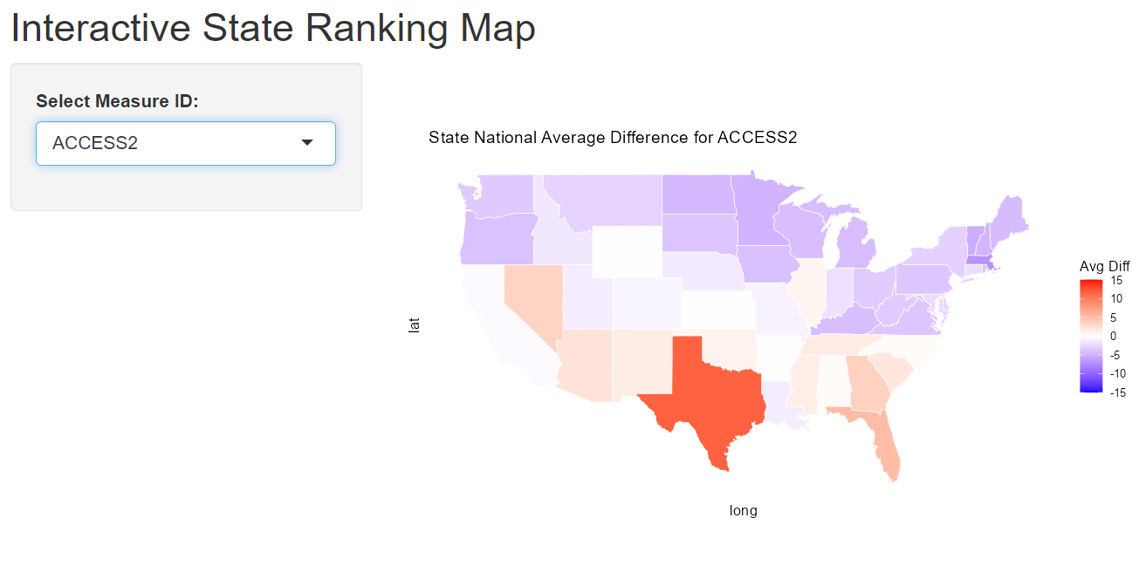
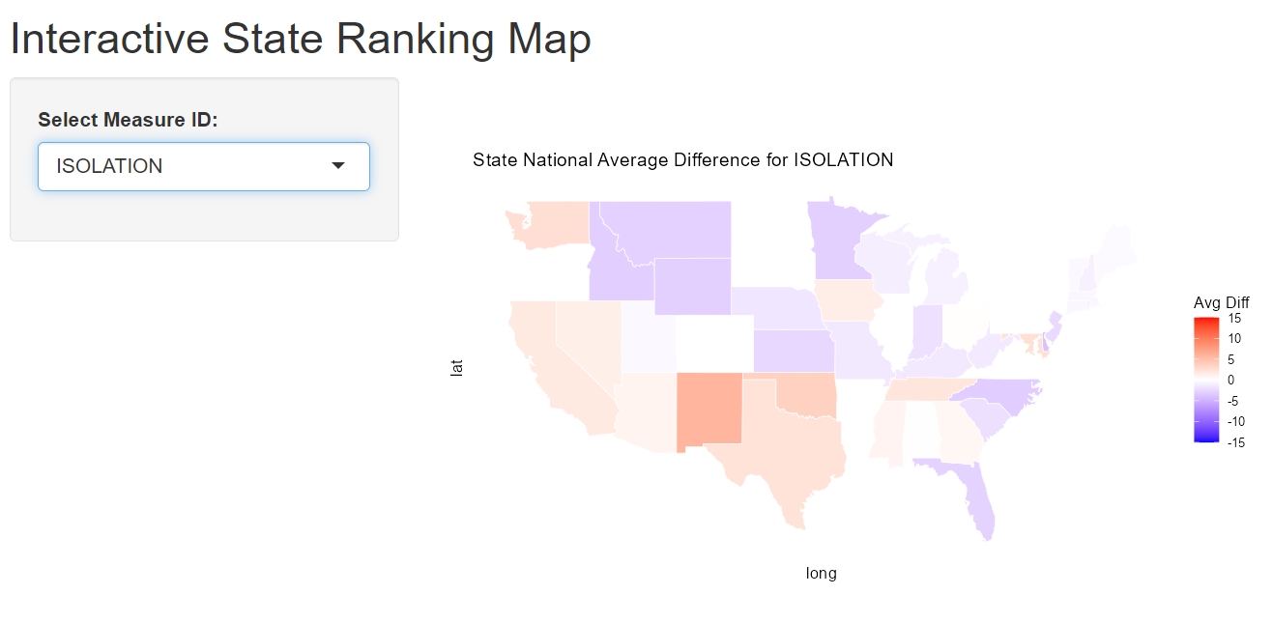
Data Visualization
I made an interactive map so you can see different measures across the united states

Slide 15
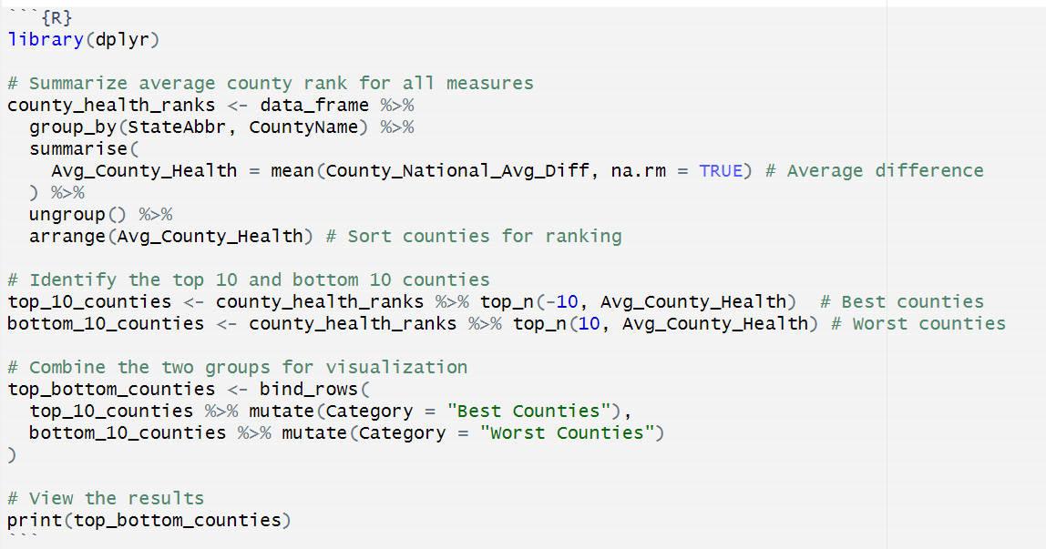
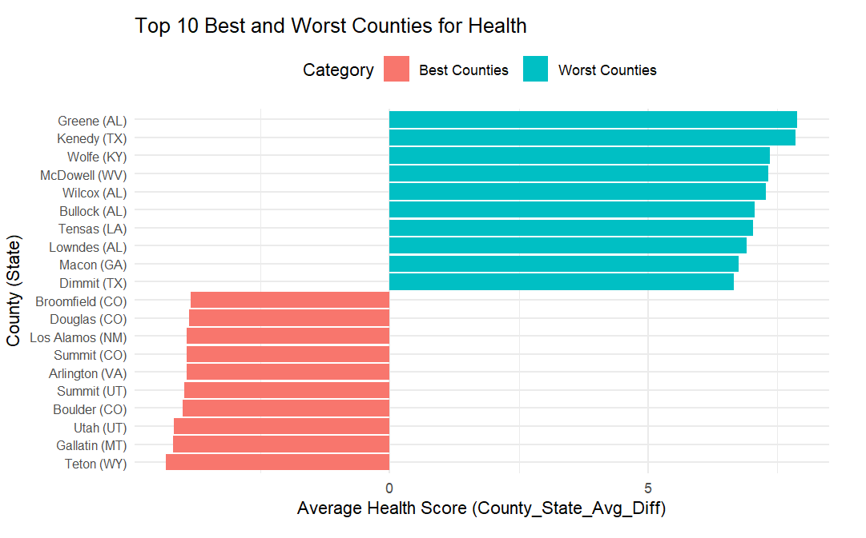
Data Visualization
I now wanted to find the top 10 best and worst counties in the United States
Had to do some data manipulation, and make a new data frame
These counties generally align with previous maps

Slide 16
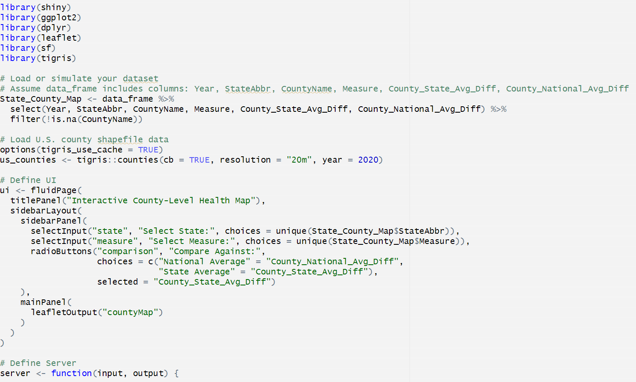
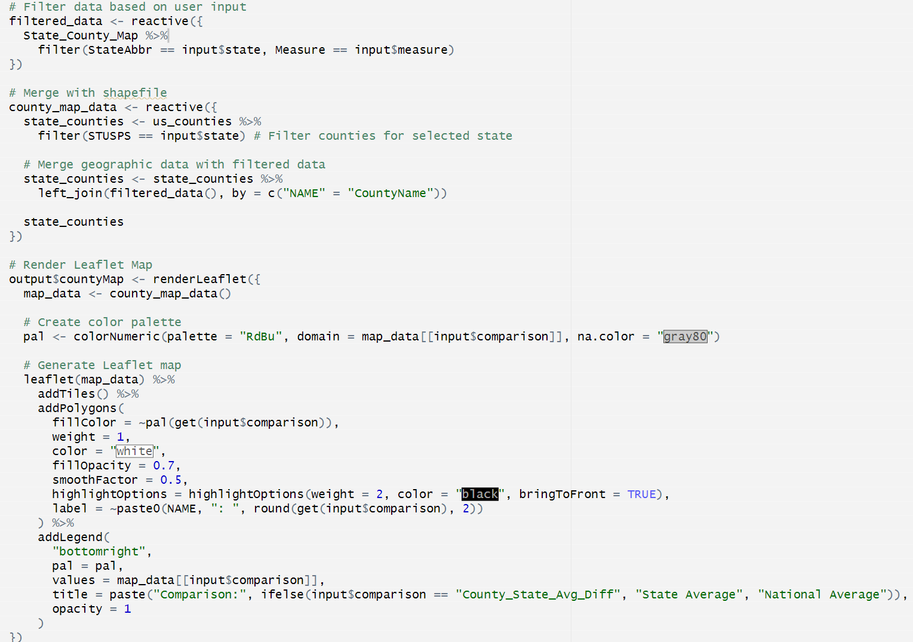
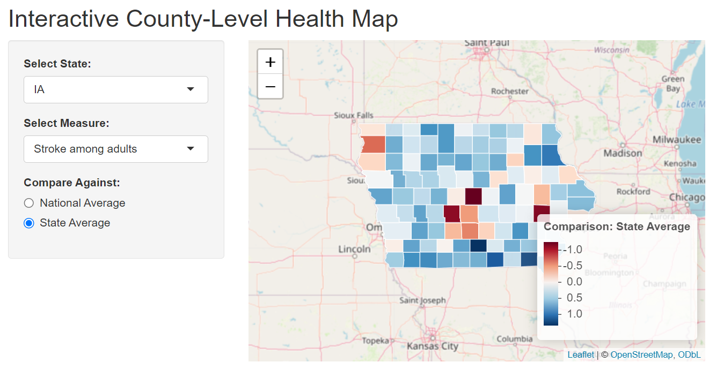
Data Visualization
I wanted to see individual counties in each state and how they compared
I made an interactive map to show this

Slide 17
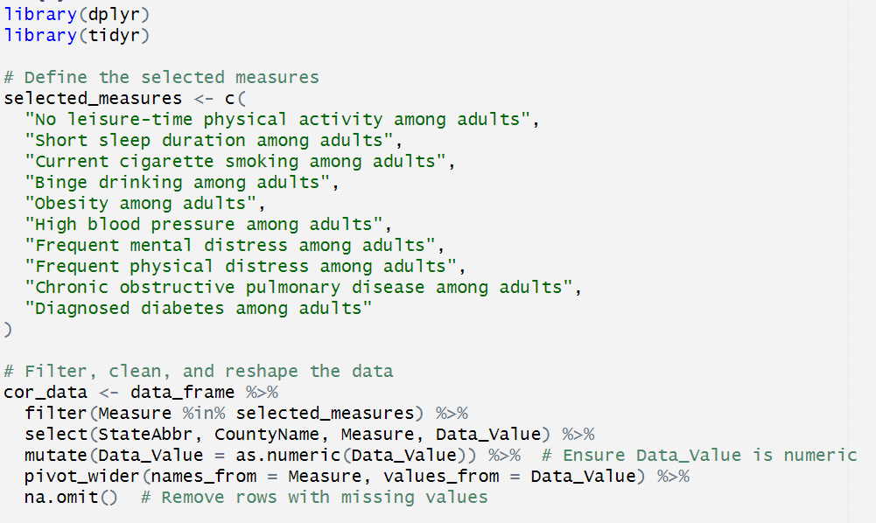
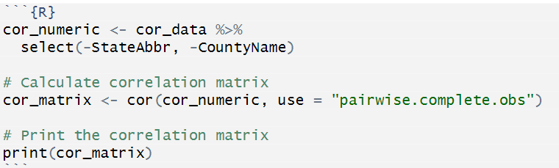
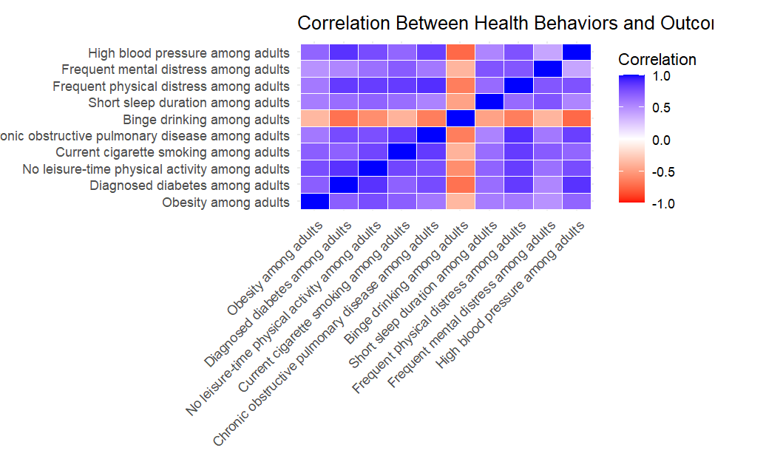
Data Visualization
I now wanted to see if there were correlations between different outcomes/ prevention/ health habits
Had to create a correlation matrix
Ran into difficulties getting the columns I needed to be numeric

Slide 18
Conclusion
States that binge drink don’t seem to be less healthy than states that do
States and counties that don’t get screenings seem to have worse outcomes
States with the worst health outcomes seem to be clustered in the south

